Slide 1
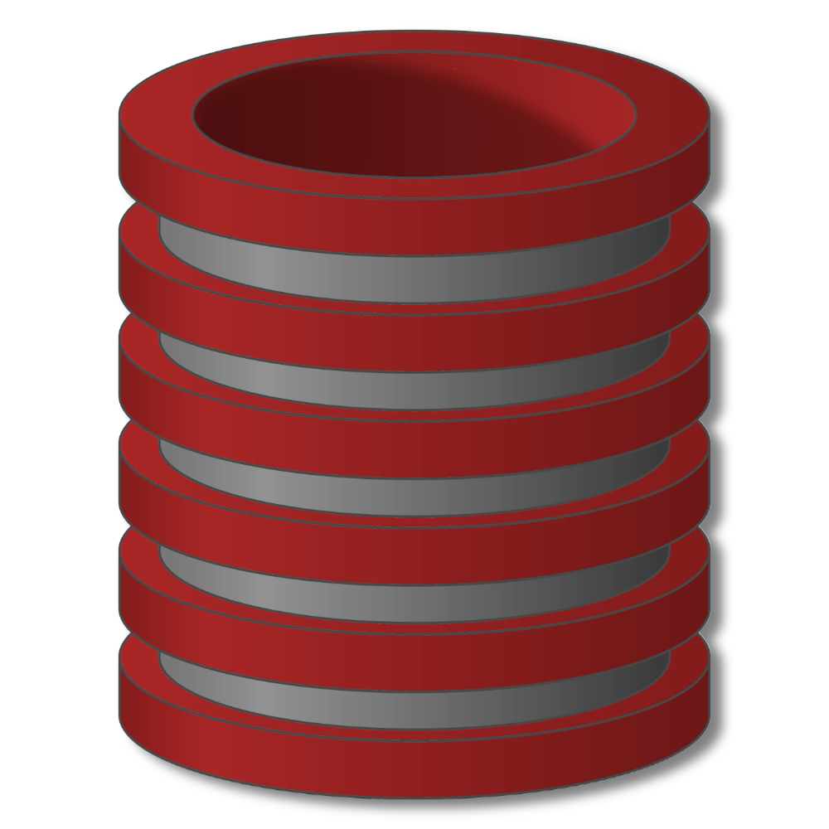
Relational Databases
Querying Relational Databases

Slide 2
Querying Relational Databases
Steps in creating and using a (relational) database
1. Design schema; create using DDL
2. “Bulk load” initial data
3. Repeat: execute queries and modifications

Slide 3
Querying Relational Databases
Ad-hoc queries in high-level language
All students with GPA > 3.7 applying to Stanford and MIT only
All engineering departments in CA with < 500 applicants
College with highest average accept rate over last 5 years
Some easy to pose; some a bit harder
Some easy for DBMS to execute efficiently; some harder
“Query language” also used to modify data

Slide 4
Querying Relational Databases
Queries return relations (“compositional”, “closed”)

Slide 5
Querying Relational Databases
Query Languages
Relational Algebra
SQL
IDs of students with GPA > 3.7 applying to Stanford
Select Student.ID
From Student, Apply
Where Student.ID=Apply.ID
And GPA>3.7 and college=‘Stanford’

